Slide 1
MODELS OF ECONOMIC DEVELOPMENT
DEPARTMENT OF GEOGRAPHY

Slide 2
KARL MARX MODEL
PRIMITIVE COMMUNE
SLAVE ECONOMY
FAUDAL ECONOMY
CAPITALISM
COMMUNISM

Slide 3
FOUR BASIC CONCEPTS OF MYRDAL MODEL
CUMULATIVE CAUSATION
BACKULASH
SPREAD EFFECT PROCESS
INCREASE IN THE ECONOMY

Slide 4
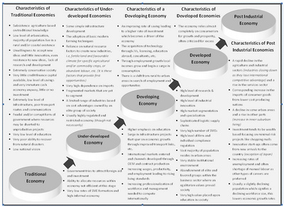
GEOGRAPHICAL GROWTH POLE THEORY

Slide 5
CENTRE PHERIPHERY MODEL BY JOHN R. FRIEDMANN
CORE REGIONS
RESOURCE FRONTIER AREAS
DOWNWARD TRANSITIONAL AREAS
SPECIAL PROBLEM AREAS

Slide 6

STAGES OF CORE PERIPHERY MODEL
PRE-INDUSTRIAL
TRANSITIONAL
INDUSTRIALISATION
POST INDUSTRIALISATION

Slide 7
THANK YOU
GOVERNMENT COLLEGE PAONTA SAHIB

